Slide 1
The best location for a new restaurant explore los angeles

Slide 2
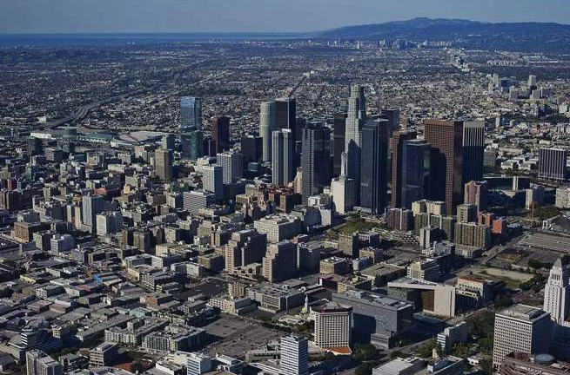
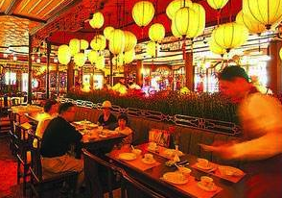
Goal of project
As we all know, the popularity of Chinese food is getting higher and higher in the world. In the United States, we can also see many Chinese restaurants. So, my question is, where is the best place for someone who wants to open a Chinese restaurant in Los Angeles?
This question is closely related to the people who plan to run their own restaurants and I believe that this can also be expanded to many other businesses.

Slide 3
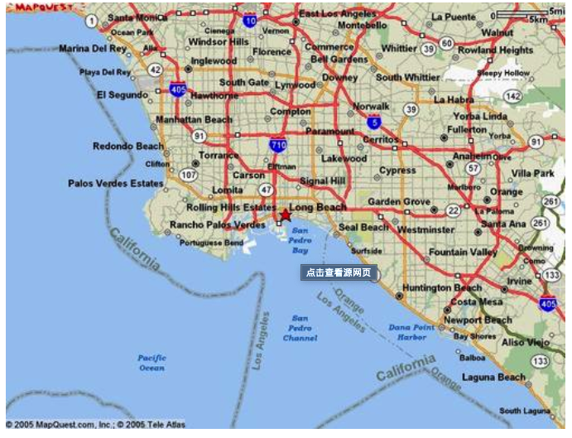
Goal of project
When finished the project, we can answer several questions as followed:
Which zone has a relative better safety?
What streets can be considered similar from commercial angle?
Where should I locate my new Chinese Restaurant in LA?

Slide 4
DATA COLLECTION
Los Angeles street distribution----------------------------------geo locations
Los Angeles Chinese restaurant information------------------geo locations tips ratings
Los Angeles street crime data etc.

Slide 5
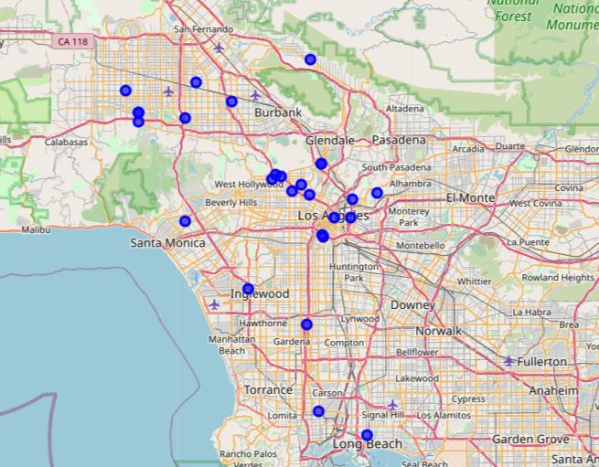
visualize all the chinese restaurant spot I got
The image does not indicate any pattern but covers quite many region of LA.

Slide 6
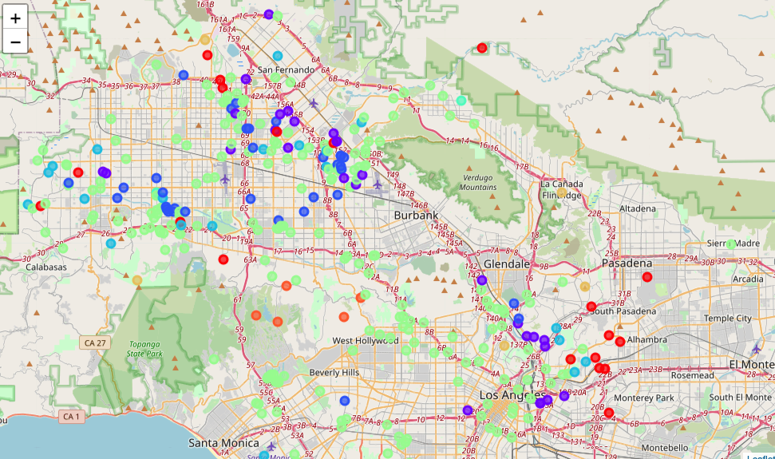
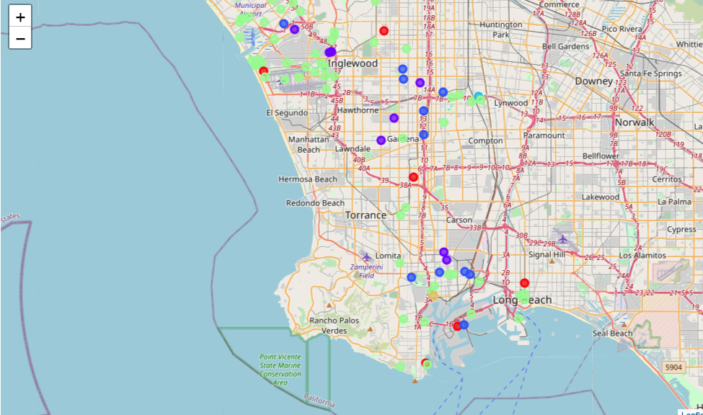
Clustereing venues data of different streets
From the image, we can know that the shallow green dots represent the most common clusters, which is cluster 5.

Slide 7
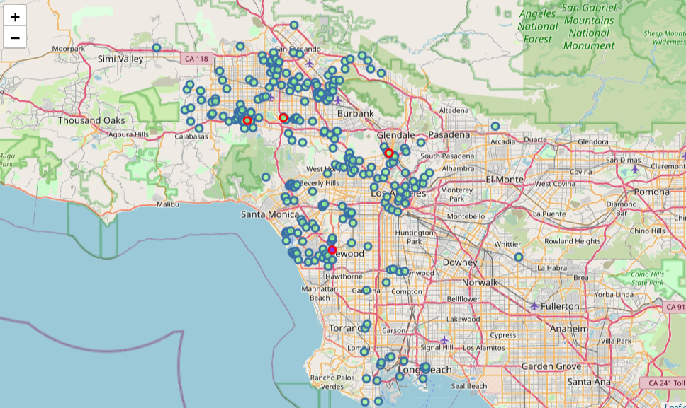
add the top 5 popular Chinses restaurant to the map.
OK, now the map gives us all the streets that are similar to the streets where the top5 Chinses restaurant reside in. From this map, we can know, after machine learning process, we can locate our restaurant in these blue dots area and we can clearly get far from the street where the top5 live in.
But, that’s not enough. We need to take other factors into our considerations.

Slide 8
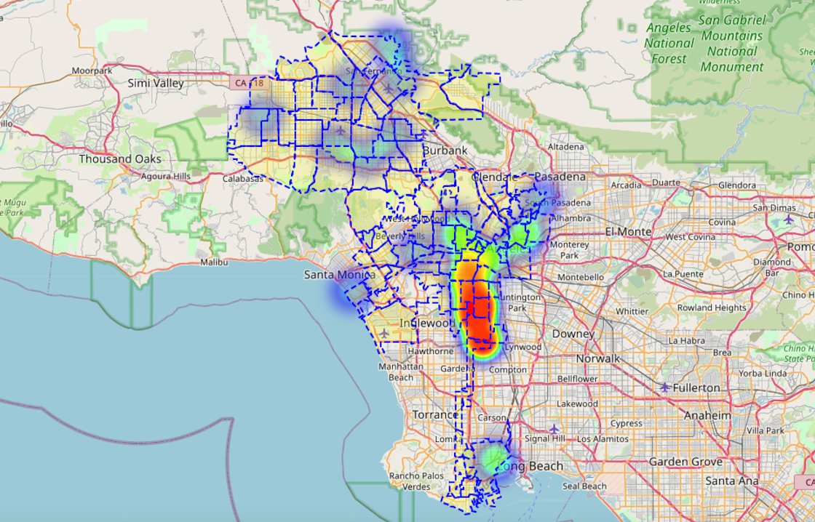
Considering crime rate
In fact, there are many more factors influencing this topic in the real world so the process should have been much more complicated. But, just like what I said, our meta data quality is not satisfying and I need to simplify this model.
Therefore, our task is to take crime rate and population as factors.
I draw a crime information data into this map. The darker the area is , the higher the crime rate is. This tells us that maybe locating our restaurant in the north of city is a better idea than in the center.

Slide 9
conclusion
Through this process, we can actually add more factors into our considering model.
Finally, we can get our conclusion by our analysis:
Crime Rata in central Los Angeles is not ideal. At the same time, because we need to avoid several strong competitors, Long beach, Burbank, San Fernando in Northwest and South Los Angeles looks like a good choice!
So, this is my project. Thanks for watching!

